Slide 1



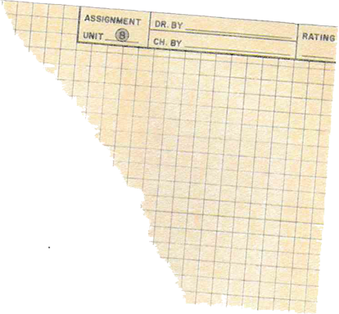

KVPD E-LEARNING SYSTEM
PSM 1
Presentation By
Muhammad Najmi Aiman Bin Jantan

Slide 2



OVERVIEW
Abstract
Introduction
Literature Review
Methodology
Analysis and Design

Slide 3


This research addresses the enhancement of the KVPD E-Learning System by identifying and mitigating weaknesses of KVPD learning traditional method. there are some problems with how students learn, like teachers going too fast, students having to spend a lot of money, issues with getting learning materials, and trouble figuring out students' skill levels. To fix these problems, we're using a method called the Prototyping Model with Evolutionary Prototyping. there were everal use case in for this system which is Login, register acoount, Manage user, Manage course, Manage learning material, Manage assessment and assignment, Record grade and Generate report. Comparative analysis of system features highlights areas for improvement. Findings contribute to the refinement of E-Learning systems, fostering a user-centric and efficient educational experience. The study concludes with insights for future research, emphasizing the continual evolution of educational technology. this system ensure teachers are more involved, students don't have to spend too much money, learning materials are easy to get, and we can figure out what level students are at in their skills.
ABSTRACT

Slide 4

INTRODUCTION

Slide 5
PROJECT BACKGOUND
PROBLEM STATEMENT
Learning involves acquiring knowledge, skills, and understanding through study, experience, or teaching. In the digital age, online learning systems provide more satisfying education, allowing students to access information on smartphones and tablets. Sekolah Menengah Vokasional Port Dickson, formerly Sekolah Menengah Teknik Port Dickson, was renamed Kolej Vokasional Port Dickson in 2013 to offer a more comprehensive vocational education, offering nine courses and preparing students for the workforce.
The KVPD learning system faces challenges due to teachers prioritizing content delivery quickly, limiting elaboration and teacher focus, and students using textbooks. Rising costs of educational materials and financial burdens also limit access to resources. Traditional methods of distributing learning materials face challenges due to technological limitations, increasing student enrollment, and department expansion. Tracking and addressing students' Sijil Kemahiran Malaysia (SKM) levels is hindered by class size, lack of standardized assessment tools, and pressure to cover curriculum content efficiently.
4 PROBLEM
High Cost and Resource Accessibility
Limited Elaboration and Teacher focus
Challenges in Distributing Learning Materials
Difficulty related to SKM Level
OBJECTIVE
3 OBJECTIVE
Analys and design the E-Learning system for KVPD using object-oriented.
Develop the web-based E-Learning system for KVPD.
Conduct acceptance testing with the stakeholders.

Slide 6
SCOPE
Module | Function | User Involve
Login | Users should be able to enter specific active student ID orteacher ID astheir username and be able to enter the password. Allow user to reset or recovery password | Teacher, Administrator and Student
Register Account | Allow students to register their new account by student enter their name, email, student ID and password. Active Student ID will be traced to register the new account. | Student
Manage User | Be able to edit and update user profile. Upload profile picture. | Teacher and Student
Assign Course and Class | Register courses for each student (10 courses) Assigned lecturer for each course for specific class. Assigned student for each class. Focus to form 5 classes (3 classes) Assigned teacher for class. | Administrator

Slide 7
SCOPE
Module | Function | User Involve
Manage Course | Allow students to browse and search for their semester course. View a list of enrolled courses. Teacher be able to edit and update the course and that be enrolled for their student. | Teacher and Student
Manage Learning Material | Allow students to access lectures notes, or other education resources like teaching video. Allow teacher to manage the learning resource. | Teacher and Student
Manage Assessment and Assignment Module | Allow students to access the online assignment, quiz, test and submit individually or in a group. Teacher be able to manage the online assignment, quiz, and the due date of the assignment. Allow teacher to track student assignment progress. Classify and filter the assessment based on SKM level. | Teacher and Student

Slide 8
SCOPE
Module | Function | User Involve
Record Grade | Allow students to view their grade of their assignment and course. Teacher be able to manage the grading of their course, assignment, quiz, and test. Show student list and give the achievement badge based on achieve of SKM level. | Teacher and Student
Track SKM Level | Teacher approves for each submission for each SKM Level Student view SKM Level progress | Teacher and Student
Generate Report | Submission Report The teacher can print out the list of the students by achievement badge. Grading Marks Report | Teacher and Student
Manage Feedback | Allow student to give feedback on learning resource. | Student

Slide 9
LITERATURE REVIEW

Slide 10






TECHNOLOGY USED
PHP
JAVASCRIPT
BADGES
SQL
LARAVEL

Slide 11
Features | UFUTURE | PutraBLAST | AUTHOR | KVPD E-Learning System
Login | √ | √ | √ | √
Register Account | √ | X | X | √
Manage Course and Class | √ | √ | √ | √
Manage User | √ | √ | X | √
Manage Course | √ | √ | √ | √
Manage Learning Material | √ | √ | √ | √
Manage Assessment and Assignment | √ | √ | √ | √
Record Grade | √ | √ | √ | √
Track SKM Level | X | X | X | √
Generate Report | X | X | √ | √
Manage Feedback | √ | √ | X | √
COMPARISON WITH EXISTING SYSTEM

Slide 12
METHODOLOGY

Slide 13
PROTOTYPING MODEL
Phase | Task | Output
Planning | Propose project. Task scheduling. Identify problem, scope and objective Collect and analyze the information. | Proposal Gantt Chart
Analysis | Collect and analyze the information | Swimlane diagram (To-Be Model) Use case diagram Use case specification Activity diagram Sequence diagram Class diagram Requirement Definition

Slide 14
Phase | Task | Output
Design | Design system architecture Design user interface of the system by using PHP Design database | Program code System architecture Data scheme and data dictionaries User interface
Prototyping Implementation (Prototype 1) | Programming Develop prototyping 1 and connection with database | Prototyping 1
Prototyping Implementation (Prototype 2) | Programming Develop prototyping 1 and connection with database | Prototyping 2
System Implementation | Implement all functions and features Test the system | System Test case Requirement Traceability Matrix

Slide 15
ANALYSIS AND DESIGN

Slide 16
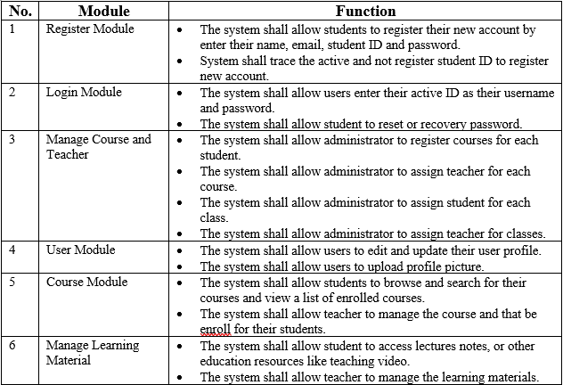
FUNCTIONAL REQUIREMENT

Slide 17
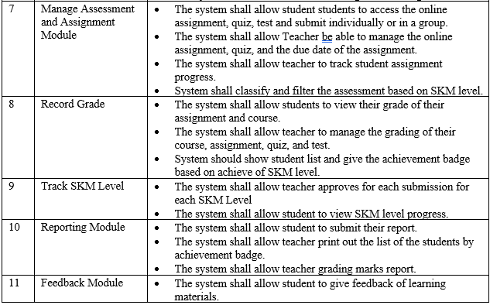
FUNCTIONAL REQUIREMENT

Slide 18
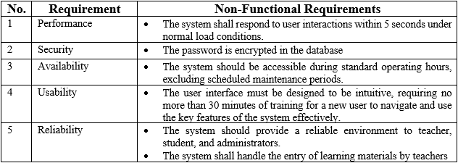
NON-FUNCTIONAL REQUIREMENT

Slide 19
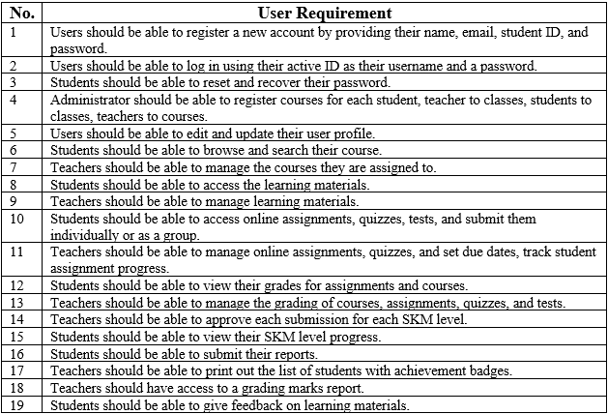
USER REQUIREMENT

Slide 20
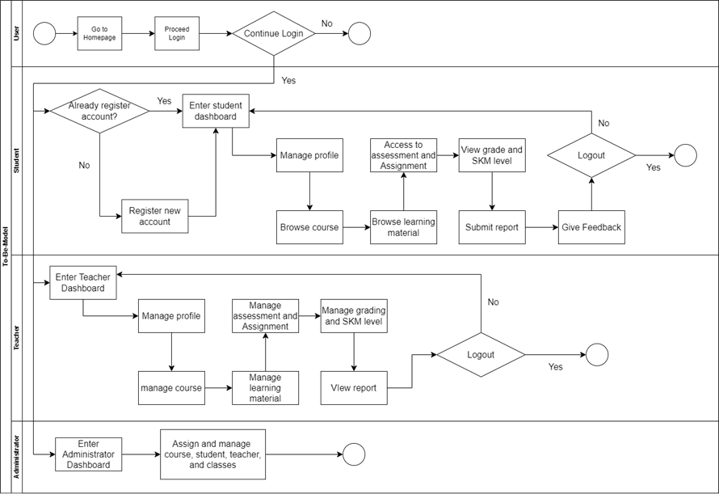
TO-BE MODEL

Slide 21
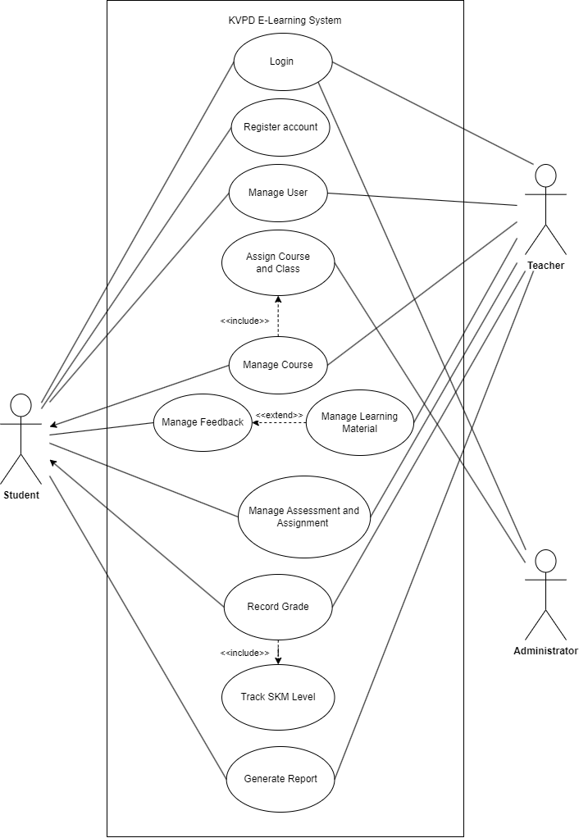
USE CASE
DIAGRAM

Slide 22
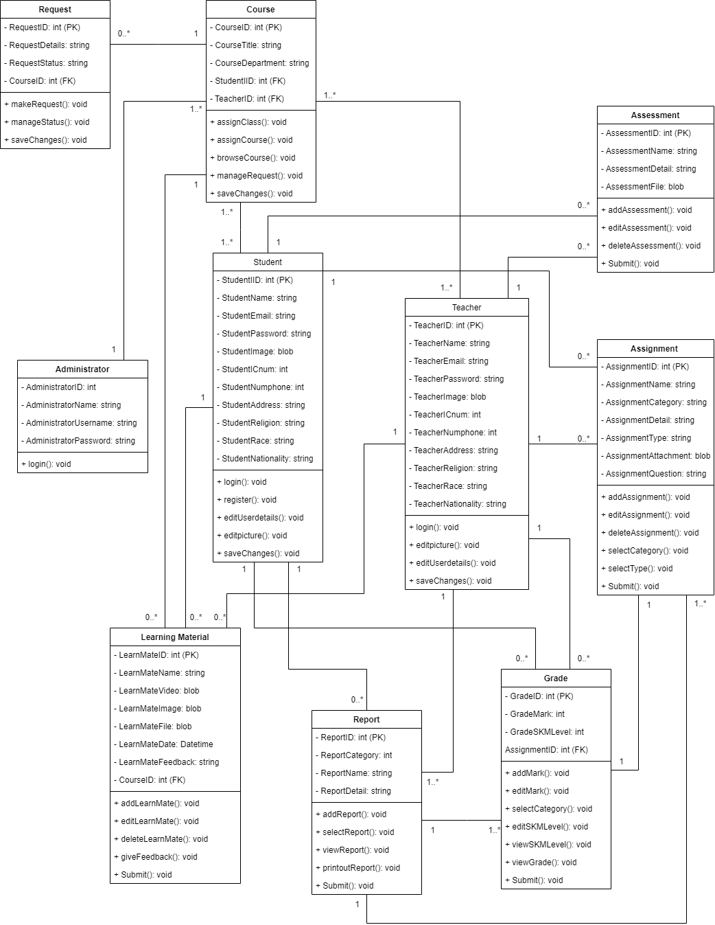
CLASS
DIAGRAM

Slide 23
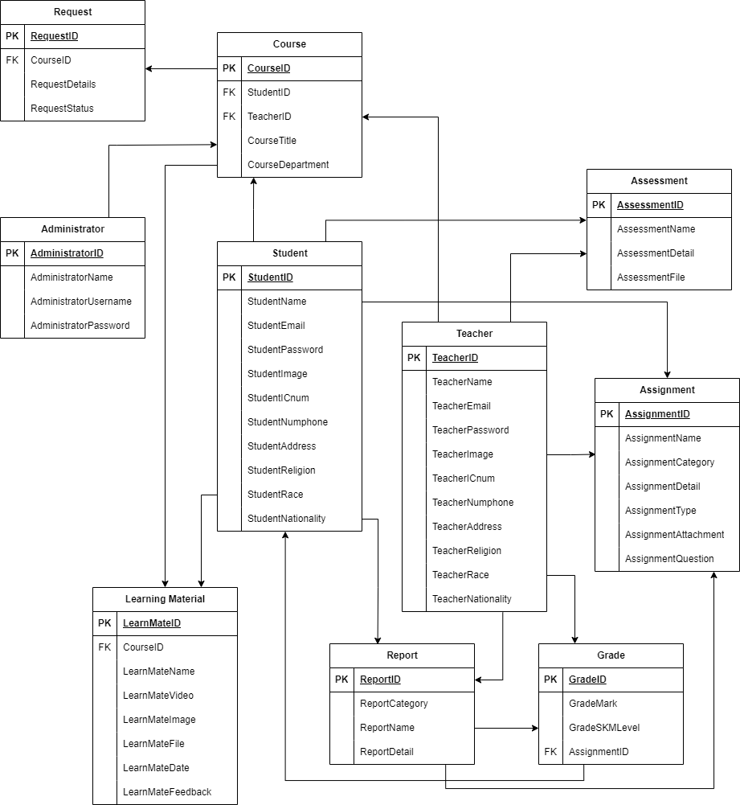
DATABASE
SCHEME

Slide 24
THANK YOU

